Slide 1


Strategies for Infant/Pediatric Respiratory Care in RSV Bronchiolitis

Slide 2

Low Flow Oxygen Therapy
Indicated for hypoxia without significant work of breathing.
Nasal cannula
(may require specialized flowmeter from NICU)
0.25 to 4 lpm depending on age
Nonrebreather Mask
10-15 lpm

Slide 3

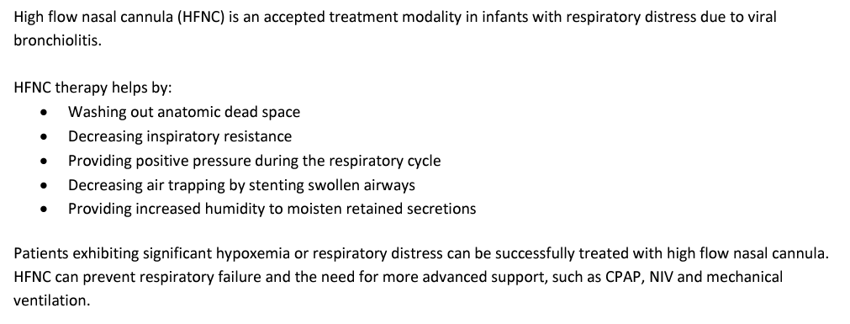
Heated High Flow Nasal Cannula Therapy (HHFNC)

Slide 4
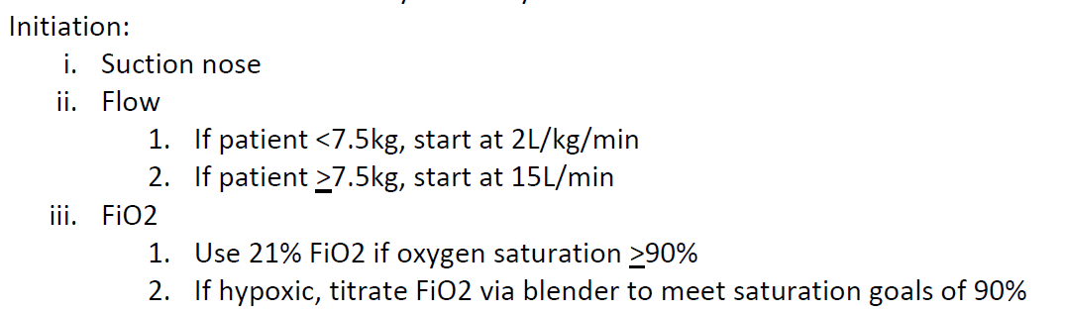
Heated High Flow Nasal Cannula Therapy (HHFNC)

Slide 5
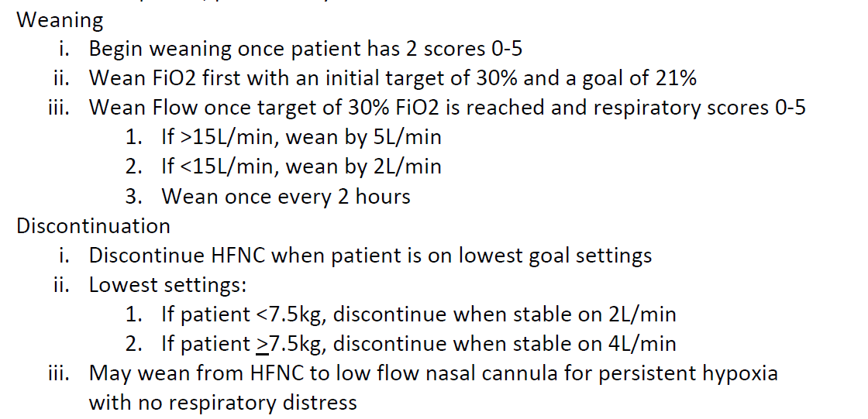
Heated High Flow Nasal Cannula Therapy (HHFNC)

Slide 6
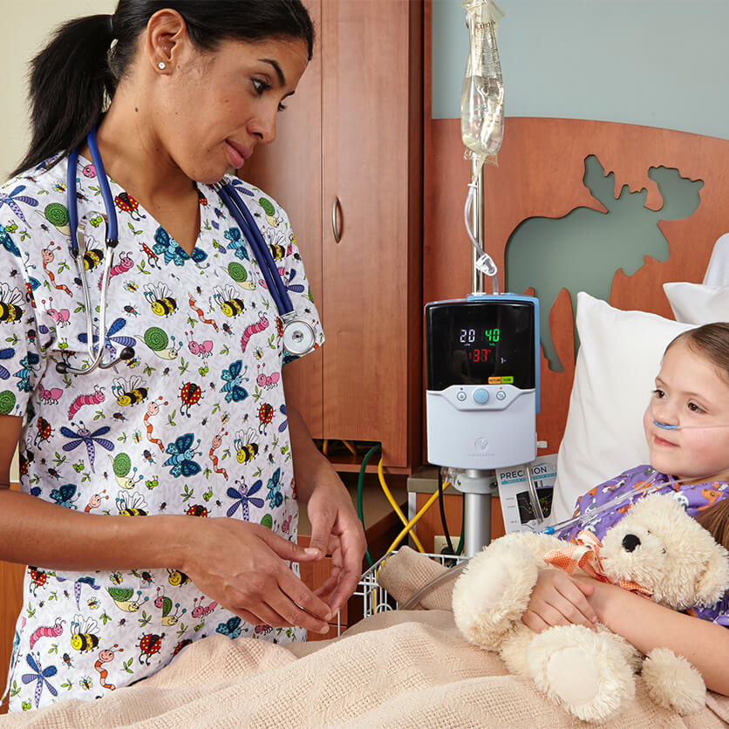
Heated High Flow Nasal Cannula Therapy (HHFNC)
Vapotherm
Neonatal/Infant – 1-8 lpm @ 21-100% FiO2
Pediatric/Adult – 5-40 lpm @ 21-100% FiO2
Integrated flowmeter, blender, heater.

Slide 7

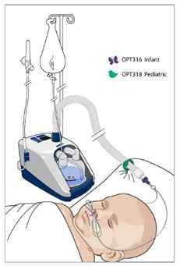
Heated High Flow Nasal Cannula Therapy (HHFNC)
Optiflow / Airvo
Neonatal (32 weeks gestation – 6 months)
1-8 lpm @ 21-100% FiO2
Requires Optiflow setup – not compatible with Airvo device.
Utilizes basic oxygen/air blender with heater.
Infant (37 weeks – 3.5 years)
1-20 lpm @ 21-100% FiO2
Can be used with Optiflow or Airvo devices
Pediatric (1-6 years)
1-25 lpm @ 21-100% FiO2
Can be used with Optiflow or Airvo devices

Slide 8
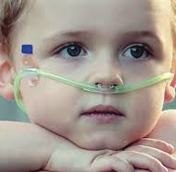
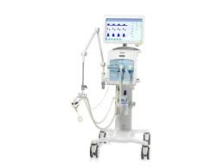
Noninvasive Positive Pressure Ventilation (NPPV)
Utilizes either a Drager v500 or vn500 ventilator to provide noninvasive ventilation.
v500 devices will need to be switched to Pediatric mode.
RAM cannula is the interface of choice.
IPAP 12-18
EPAP 5-10
Backup rate 30

Slide 9
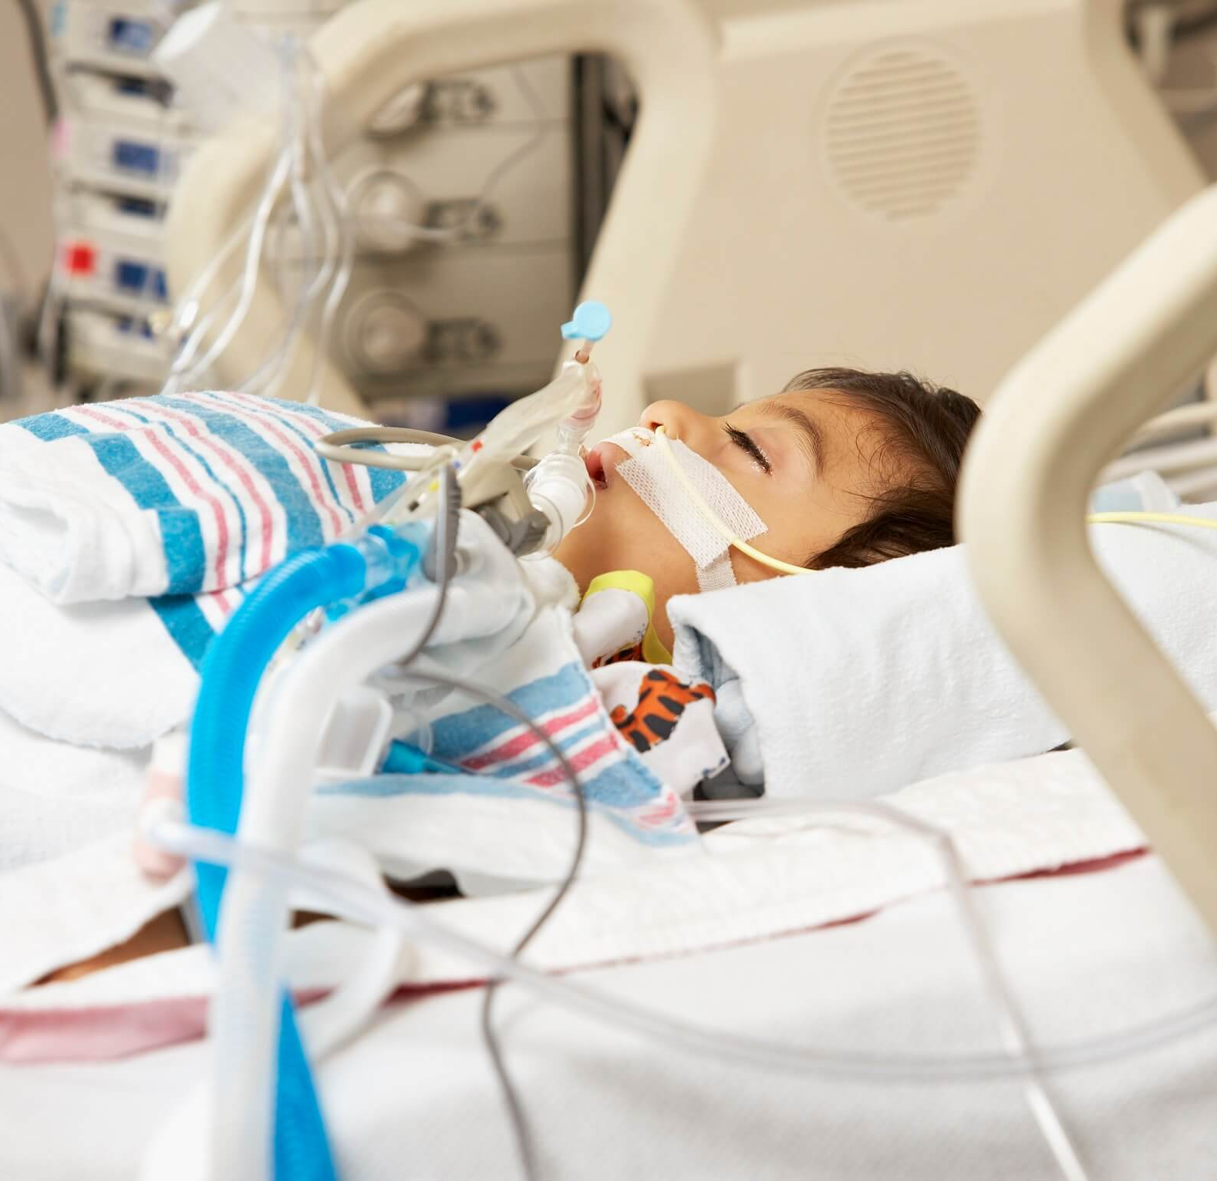
Mechanical Ventilation
Utilizes either a Drager v500 or vn500 ventilator.
Devices will need to be switched to Pediatric mode.
PC-SIMV is preferred
Vt goal 6-8ml/kg (Max PIP 30-50 cmH2O)
PEEP 3-15 cmH2O (start with current CPAP level)
Rate ~30 bpm to start
Permissive hypercapnia:
pH ≥7.25, avoid overdistention

Slide 10
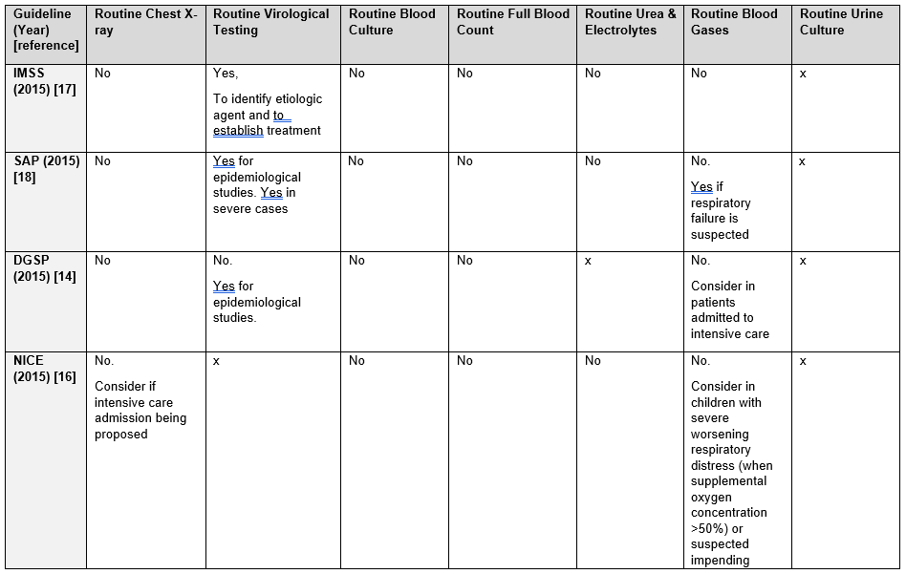
Adjunctive therapies
Guideline recommendations to support diagnosis of bronchiolitis

Slide 11
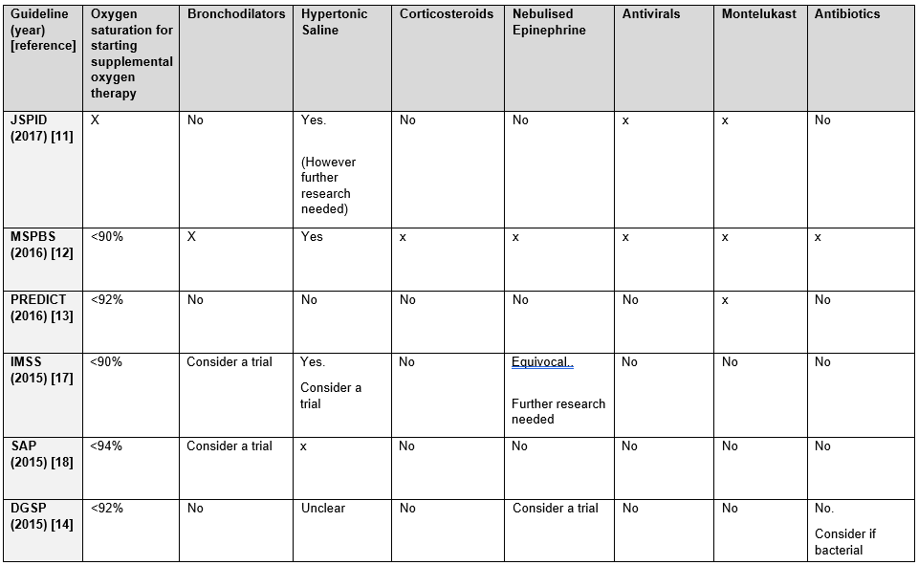
Adjunctive therapies
Guideline recommendations for the routine pharmacological management of bronchiolitis.

Slide 12
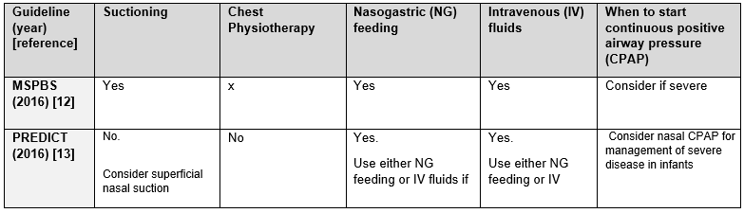
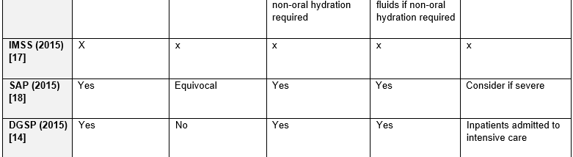
Adjunctive therapies
Guideline recommendations for general supportive management of bronchiolitis

Slide 13
References
Hayes, D. and others; American Thoracic Society Assembly on Pediatrics. (2019). Home oxygen therapy for children: An official American Thoracic Society Clinical Practice Guideline. American Journal of Respiratory and Critical Care Medicine, 199(3), e5-e23. doi:10.1164/rccm.201812-2276ST (Level VII)
Topjian, A.A. and others. (2020). Part 4: Pediatric basic and advanced life support: 2020 American Heart Association guidelines for cardiopulmonary resuscitation and emergency cardiovascular care. Circulation, 142(16 Suppl. 2), S469-S523. doi:10.1161/CIR.0000000000000901 Retrieved October 12, 2021, from https://www.ahajournals.org/doi/10.1161/CIR.0000000000000901 (Level I)
Tasker RC. Bronchiolitis. Pediatric and Neonatal Mechanical Ventilation. 2013 Oct 8:1291–311. doi: 10.1007/978-3-642-01219-8_50. PMCID: PMC7122073.
Amir Kirolos, Sara Manti, Rachel Blacow, Gabriel Tse, Thomas Wilson, Martin Lister, Steve Cunningham, Alasdair Campbell, Harish Nair, Rachel M Reeves, Ricardo M Fernandes, Harry Campbell, RESCEU Investigators, A Systematic Review of Clinical Practice Guidelines for the Diagnosis and Management of Bronchiolitis, The Journal of Infectious Diseases, Volume 222, Issue Supplement_7, 1 November 2020, Pages S672–S679, https://doi.org/10.1093/infdis/jiz240

